Slide 1


ICS5118 - Facial Emotion Recognition
Jerome Agius

Slide 2
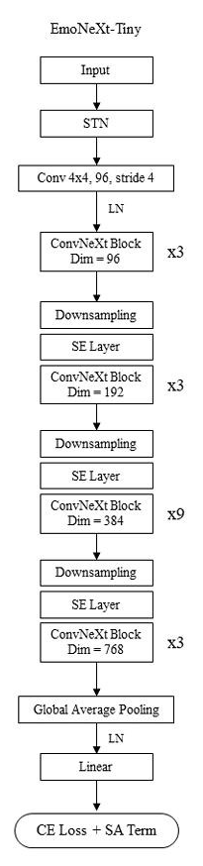
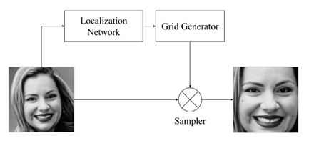
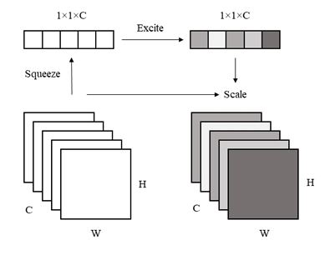
SOTA Models (1)
EmoNeXt
Built upon Facebook’s ConvNeXt backbone
Spatial Transformer Network (STN)
Squeeze-and-Excitation (SE)
Self-regularisation mechanism integrated into the loss function
Self-attention regularisation for balanced representation
Final loss: Cross Entropy + Self-Attention Regularisation
STN Architecture
Squeeze-and-Excitation Process
EmoNeXt Architecture

Slide 3
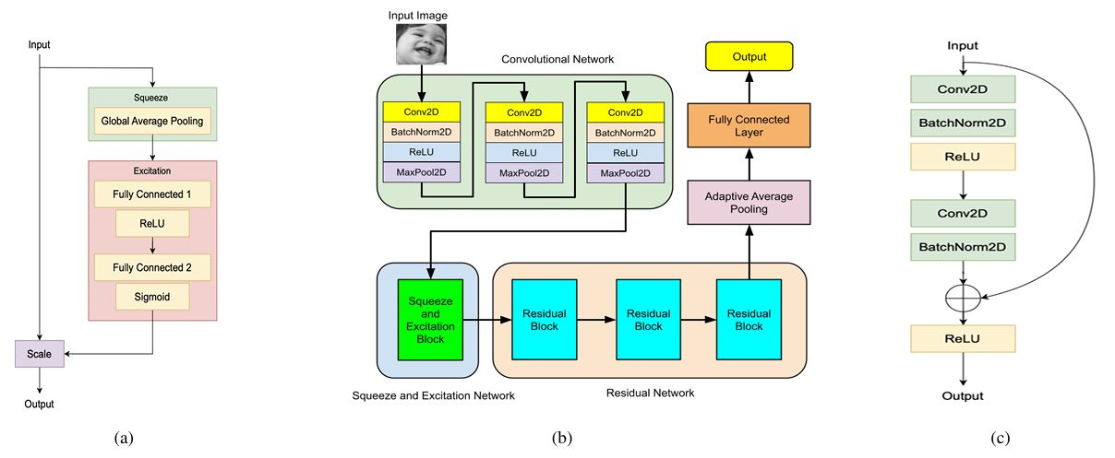
SOTA Models (2)
ResEmoteNet
Built upon a traditional CNN backbone + Residual connections
Three convolutional layers with batch normalization and max pooling
Squeeze-and-Excitation (SE) block (Structure denoted in a)
Residual blocks (Structure denoted in c)
Adaptive Average Pooling (AAP) for flexible output sizing
Classifier layer for final emotion prediction
SE Block (a) | ResEmoteNet Architecture (b) | Residual Block (c)

Slide 4
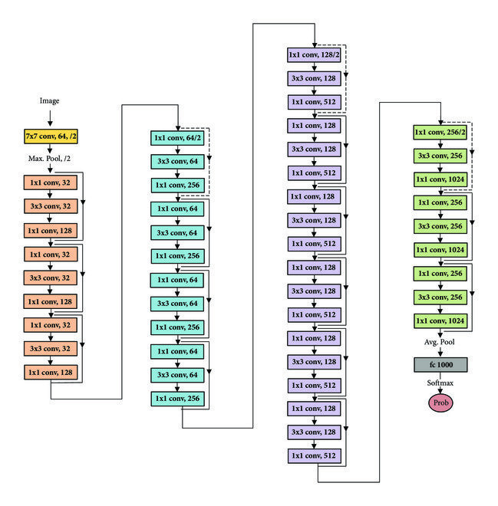
SOTA Models (3)
ResNet50
Baseline model
Residual connections
50-layer deep CNN architecture
Five main stages starting with a 7×7 convolution and max pooling
Residual blocks with three-layer bottlenecks
Downsampling via strided convolutions
Global average pooling before the final fully connected layer
Optimized for large-scale image recognition tasks
ResNet50 Architecture

Slide 5
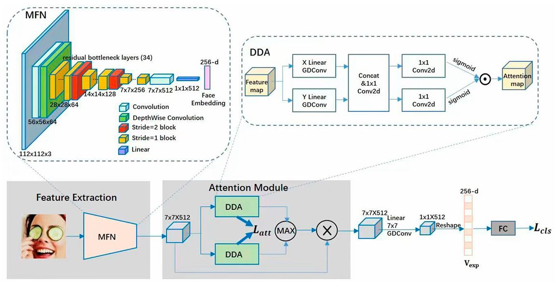
SOTA Models (4)
DDAMFN++ (Dual-Direction Attention Mixed Feature Network)
Two main parts:
MFN (Mixed Feature Network)
Adapted from MobileFaceNet
Non-Residual & Residual Blocks
Different kernel sizes
PReLU Activation Function
Adjusted Network Depth
Coordinate Attention
DDAN (Dual-Direction Attention Network)
Horizontal & vertical attention maps
Linear GDConv - Assign different importance to spatial positions
Combines attention maps.
Attention loss - Heads focus on different areas.
The output feature map processed by a linear GDConv layer
and reshaped into a 512-dimensional vector.
Fully connected layer - predictions
DDAMFN++ Architecture

Slide 6
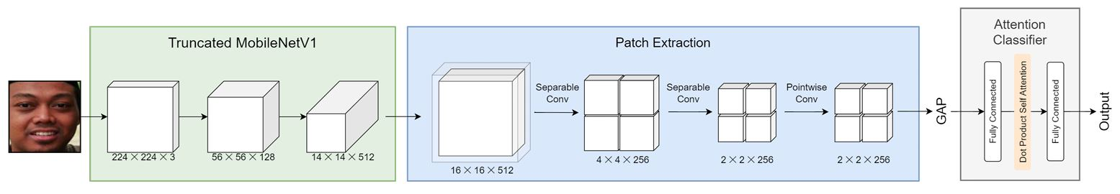
SOTA Models (5)
Patt-Lite
Three components:
Truncated MobileNetV1 backbone
Patch Extraction block
Global Average Pooling (GAP)
Attention classifier with dot-product self-attention
Lightweight design
Patt-Lite Architecture

Slide 7
Model Evaluation
Benchmark Datasets
AffectNet, RAF-DB, FER2013 (In-The-Wild)
JAFFE, and CK+ (In-Lab)
Align & Crop / No Grayscale
Consistent label mappings (0-7)
Training
In-The-Wild only
Same splits (train-test-validation)
Hyperparameters
LR: 0.001
Batch size: 16
Momentum: 0.9
Weight decay: 0.0001
Patience = 15
Exception: EmoNeXt LR: 0.0001 Batch size: 32
Evaluation
Label mismatch handling:
Unavailable labels in test set → sample excluded.
Model outputs outside label set → prediction invalid.
Same / Cross Domain
Accuracy

Slide 8
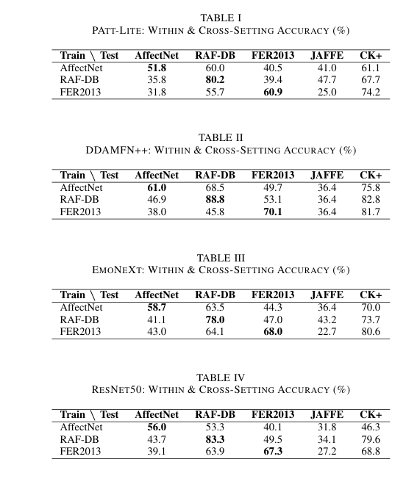
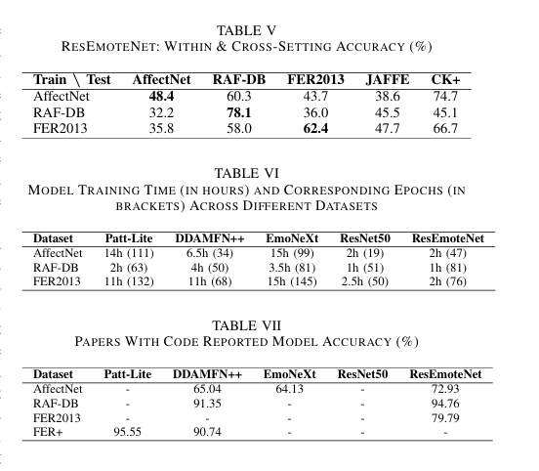
Model Results (1)
SOTA Model
DDAMFN++
Overall accuracy outperformed other models
Strong cross-domain generalization (82.8% on CK+)
JAFFE performance
Poor performance overall
Limited generalisation for datasets with narrow demographics
Importance of training data diversity
Raises ethical concerns about deploying these models in diverse real-world settings.
Models performed significantly better on CK+

Slide 9
Model Results
Efficiency and Practicality
ResNet-based models
Trained faster still performing well.
Example: ResNet50 reached 83.3% in just 1 hour on RAF-DB.
DDAMFN++ is more accurate but takes 4+ hours to train.
RAF-DB shorter training times with high accuracy.
Reproducibility and Consistency
Compared results with Papers With Code benchmarks:
Performance drops - PAtt-Lite & DDAMFN++ on FER2013 vs FER+.
Suggests sensitivity to label variations and training splits.
EmoNeXt and ResEmoteNet underperformed relative to published benchmarks.
DDAMFN++ better alignment with reported results, excluding FER2013.
Importance of consistent labels and careful evaluation practices.

Slide 10
Ethical Consideration
EU AI Act Regulations
Bans FER in high-risk contexts like education and workplaces.
Prohibits use for manipulation, exploitation, or untargeted biometric data collection.
Mandates strict oversight (e.g., risk assessments, transparency, bias mitigation) for FER in permitted high-risk settings.
Considerations
Results raises ethical concerns for Real-world deployment
Accuracy ranges from the low 50s to high 70s (Not ideal)
Poor performance (unseen datasets), crucial for real-world reliability.
Models struggle with generalisation (JAFFE)

